Slide 1
PRODUCT DIRECTORY WEBSITE
ZUELLIG PHARMA VIETNAM

Slide 2
CONTENTS
WHY – The Rationale of New Initiative
HOW – Development Process
ACHIEVEMENT – ZPVN Product Directory Website
WHAT NEXT – Ideas for Stage 2

Slide 3




ZPVN Product Directory | WHY…?
Trade Return: Initial Quality Assessment
Temperature Excursion in Branch Transfer Shipment 25ºC<TºC≤30⁰C
Actual Storage Condition: 25ºC<TºC≤30⁰C
Hundreds of SKUs quarantined for manual checking of storage condition
QA/QC and Warehouse: Workload and Time Pressure
Stock movement for checking
Manpower resources perform urgent/manual check, record and report…
Human mistakes due to time pressure and manual process

Slide 4
CONTENTS
WHY – The Rationale of New Initiative
HOW – Development Process
ACHIEVEMENT – ZPVN Product Directory Website
WHAT NEXT – Ideas for Stage 2

Slide 5




ZPVN Product Directory | HOW…?
Project – IT – QA meeting: Develop Process
Developing the website
System Source
Timeline
Scope of work
Things to do list and requirement
List of Tasks
Person-In-Charge
Target completion date
Change control
History and traceability
Product data preparation
How to collect / update data
User and Admin rights
Data extraction
Notes:
Flowchart or summary of what we did with IT to develop (including timing)
List of required system features in Stage 1

Slide 6
ZPVN Product Directory | HOW…?
Developing the website
System Sources:
Sysaid: available tool, all users can log-in, however low capacity for data storage
Sharepoint: http://vnzpapp07/admin/SitePages/Home.aspx: Difficult for accessing to all, as users are from multiple sites
eZRx: https://ezrx.com.vn/main.asp, sufficient capacity for product pictures storage, all users can log-in, but this is being used for customers.
Put the product database in common/shared disk drive, everyone can use, but easy to upload and adjust word/excel/picture files
Develop ZPV own website by local IT
Using 3rd party service, with additional cost
Timeline:
First discussion Source chosen Website upload and test Go-Live
January 2016 April 2016 May and Jun 2016 July 2016
System Features/Scope of work:
Mass upload/update
Report Extraction: multiple choices for filters
Synchronizes between SDS and website weekly (Alerted mail for those “not-yet-updated” products in Product Directory
Notes:
Flowchart or summary of what we did with IT to develop (including timing)
List of required system features in Stage 1

Slide 7
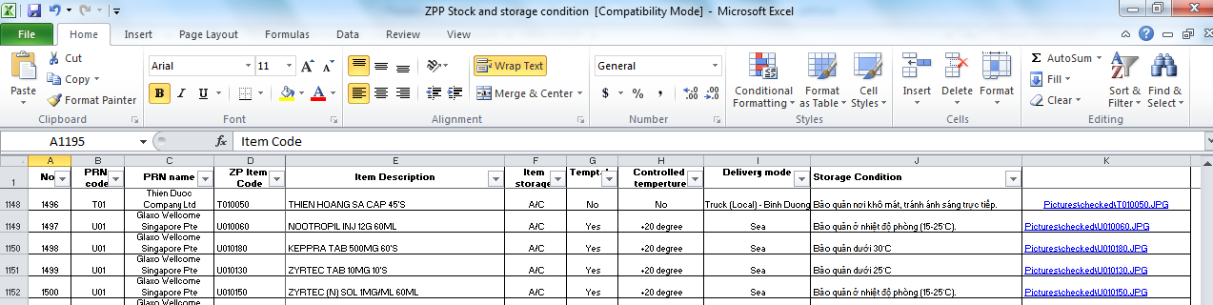
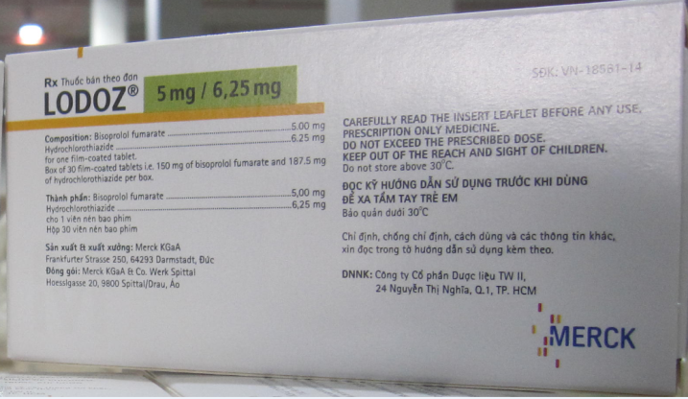
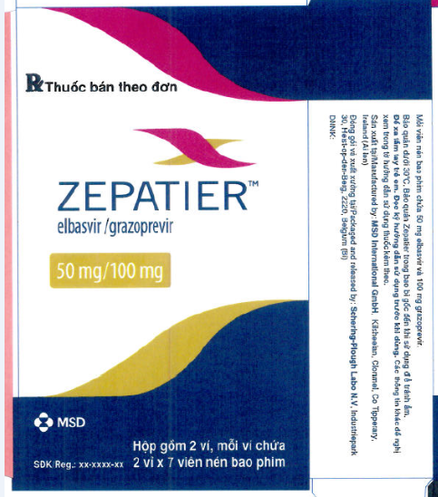
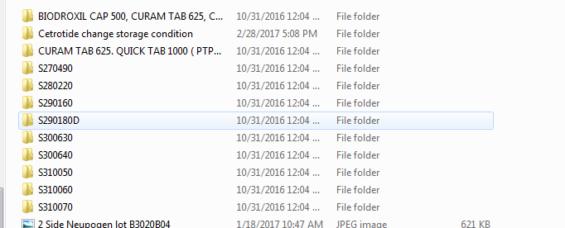
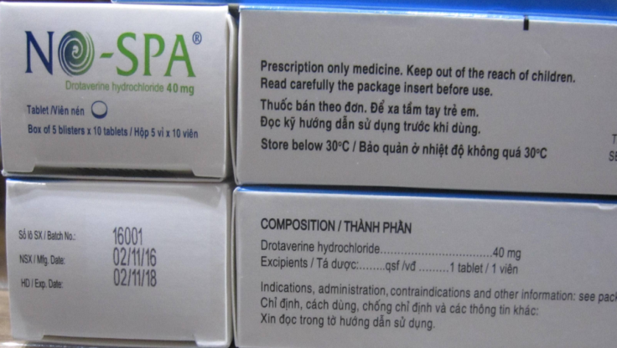
ZPVN Product Directory | HOW…?
Product data preparation
Notes:
Flowchart or summary of what we did with IT to develop (including timing)
List of required system features in Stage 1

Slide 8
CONTENTS
WHY – The Rationale of New Initiative
HOW – Development Process
ACHIEVEMENT – ZPVN Product Directory
WHAT NEXT – Ideas for Stage 2

Slide 9
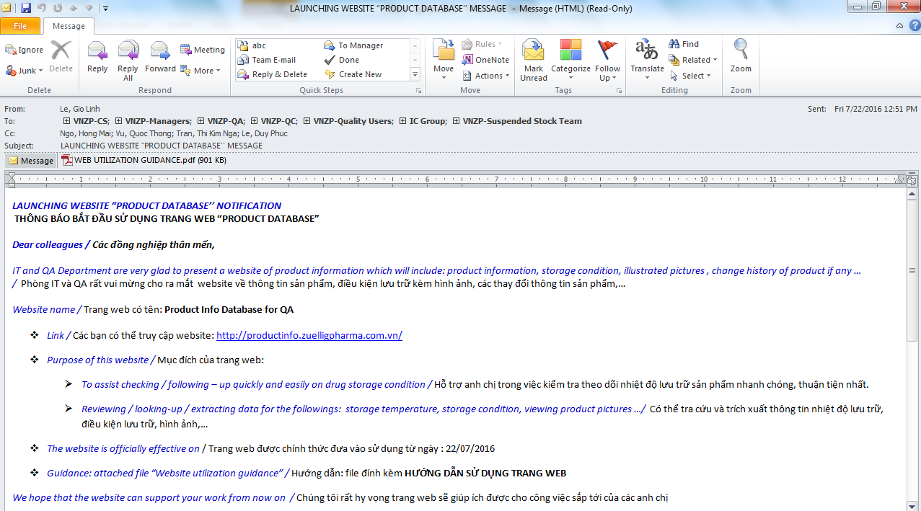
ZPVN Product Directory | System Overview…
Launching date: 22/07/2016

Slide 10
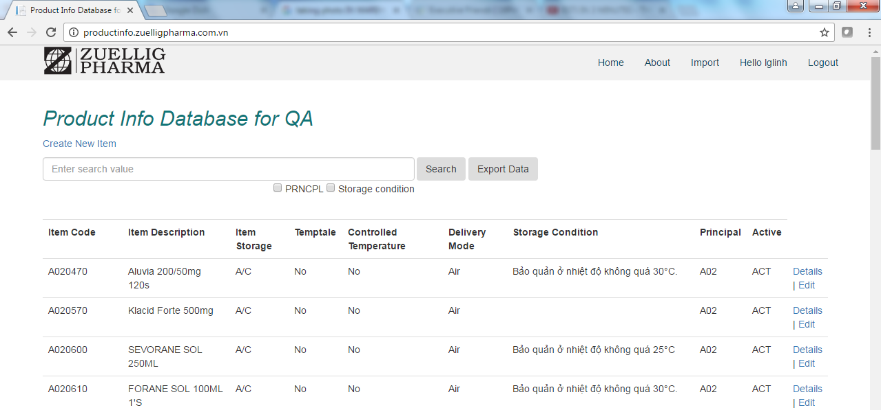
ZPVN Product Directory | System Overview…
Main Screen

Slide 11
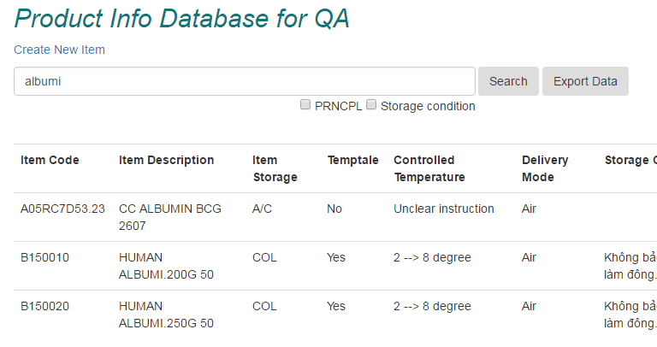
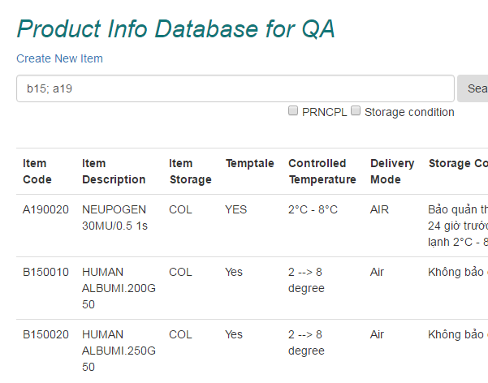
ZPVN Product Directory | System Overview…
By name
By list of Principle

Slide 12
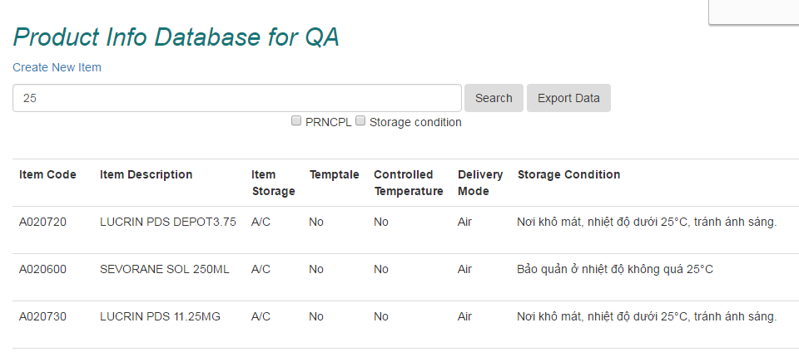
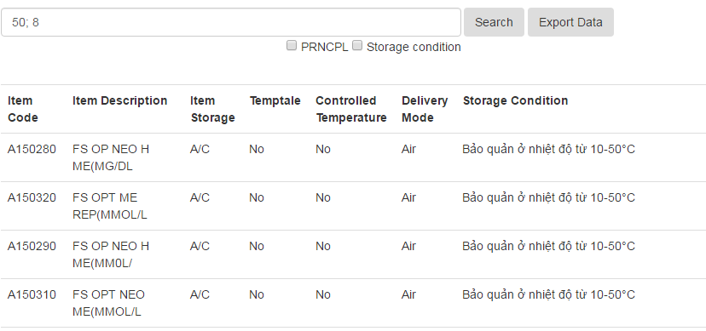
ZPVN Product Directory | System Overview…
By storage condition
By list of storage condition

Slide 13
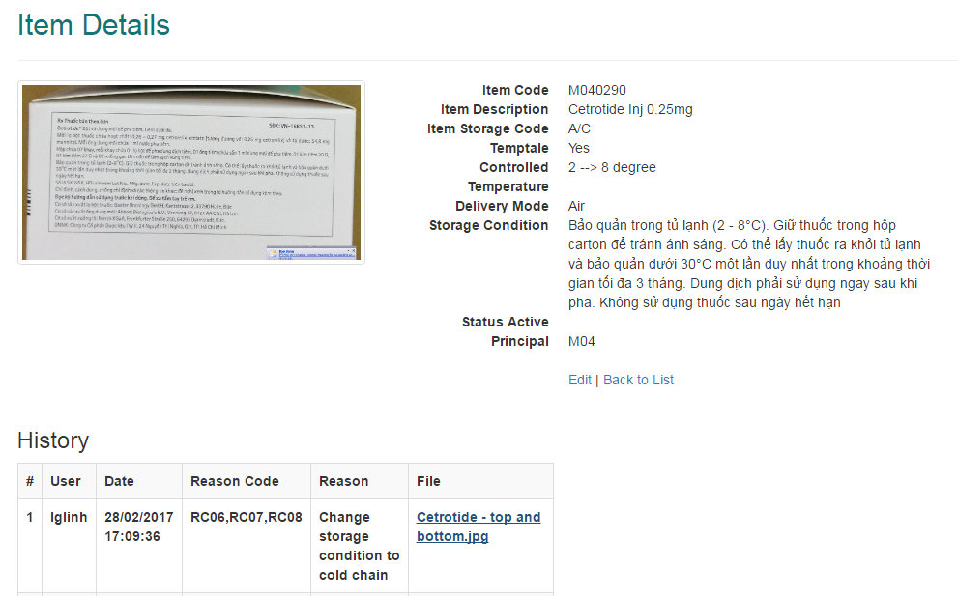
ZPVN Product Directory | System Overview…
Key Descriptions and Change History:
Easy to update and follow up product history

Slide 14
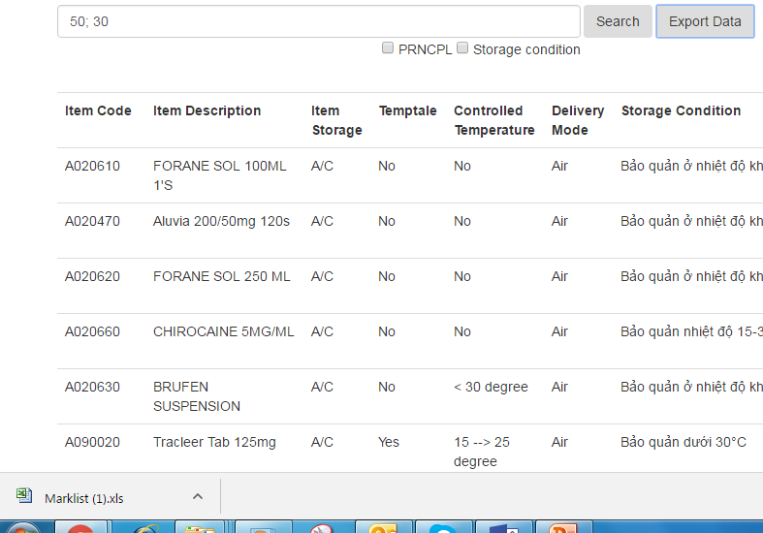
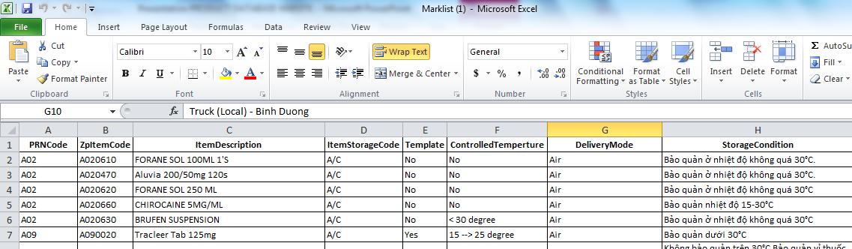
ZPVN Product Directory | System Overview…
Easy to extract information to Excel spreadsheet

Slide 15
CONTENTS
WHY – The Rationale of New Initiative
HOW – Development Process
ACHIEVEMENT – ZPVN Product Database Website
WHAT NEXT – Ideas for Stage 2

Slide 16
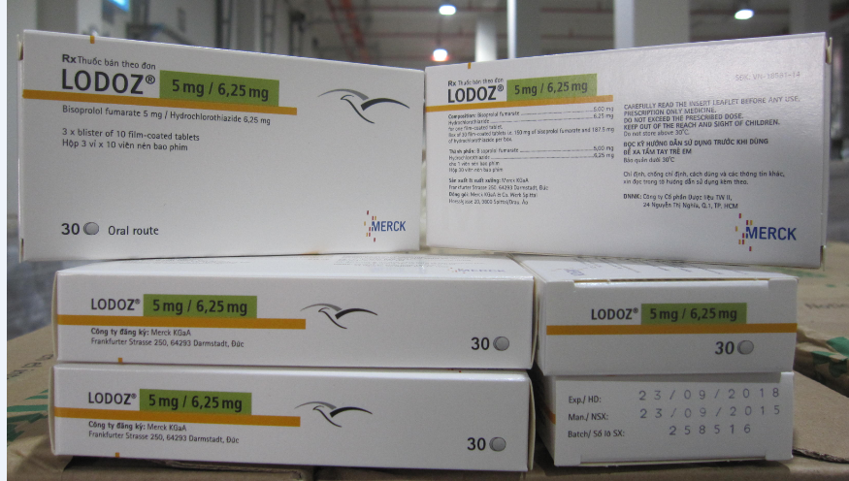
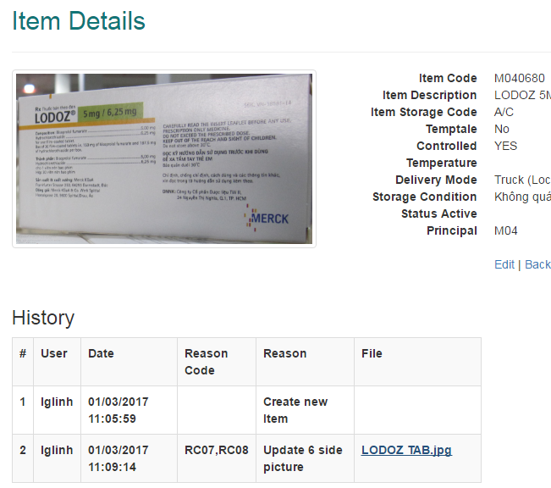
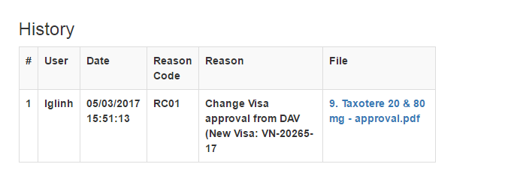
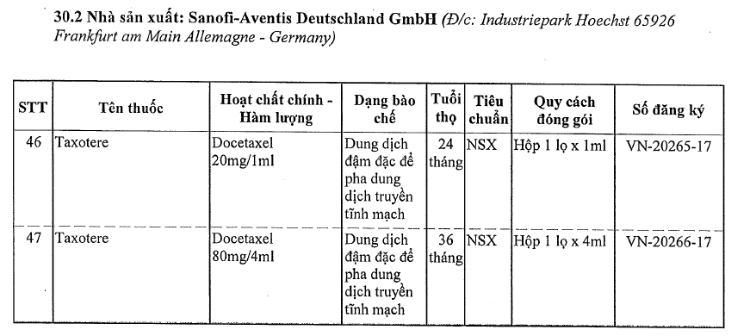
ZPVN Product Directory | What’s Next…
Operation / Sale: New product picture
Regulation: Change history follow up
Notes:
How about idea of Product Visa#

Slide 17

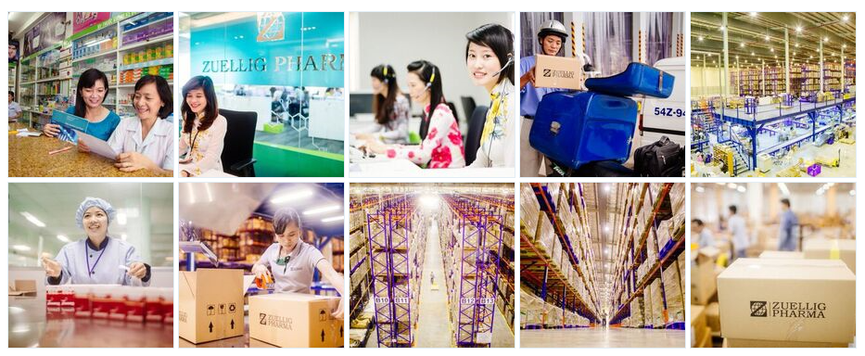
Thank You
© Copyright 2012 by Zuellig Pharma Asia Pacific.
All Rights Reserved

